Slide 1


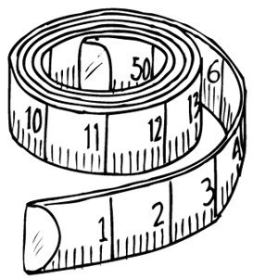
Early Years
Maths Information Meeting
2021/2022

Slide 2
Aim OF THIS SESSION
To understand how we teach maths.
To understand what is expected of children by the end of EYFS.

Slide 3
So how do we teach
Maths the foundation stage?
Carpet session each day linked to White Rose Maths Scheme
Cross-curricular table top activities indoors and outdoors
Talk for learning during free play
Thinking
Self-discovery
Problem solving
Asking questions
Real-life learning
Practical and engaging lessons
‘I hear and I forget. I see and I remember. I do and I understand.’ (Chinese Proverb)

Slide 4
Number

Slide 5
What is expected of the children?
Children in reception will be
learning to:
Count objects, actions and sounds.
Subitise.
Link the number symbol (numeral) with its cardinal number value.
Count beyond ten.
Compare numbers.
Understand the ‘one more than/one less than’ relationship between consecutive numbers.
Explore the composition of numbers to 10.
Automatically recall number bonds for numbers 0–5 and some to 10.

Slide 6
At the end of the Reception year, we assess children to these objectives and they will either be emerging, expected or exceeding.
Mathematics
ELG: Number
Children at the expected level of development will:
- Have a deep understanding of number to 10, including the composition of each number;
13
- Subitise (recognise quantities without counting) up to 5;
- Automatically recall (without reference to rhymes, counting or other aids) number bonds up to 5 (including subtraction facts) and some number bonds to 10, including double facts.
ELG: Numerical Patterns
Children at the expected level of development will:
- Verbally count beyond 20, recognising the pattern of the counting system;
- Compare quantities up to 10 in different contexts, recognising when one quantity is greater than, less than or the same as the other quantity;
- Explore and represent patterns within numbers up to 10, including evens and odds, double facts and how quantities can be distributed equally.
Exceeding- children estimate a number of objects and check quantities by counting to 20. They solve practical problems that involve combining groups of 2,5 or 10, or sharing into equal groups.

Slide 7
Shape, space and measure

Slide 8
What is expected of the children?
Children in reception will be
learning to:
Select, rotate and manipulate shapes to develop spatial reasoning skills.
Compose and decompose shapes so that children recognise a shape can have other shapes within it, just as numbers can.
Continue, copy and create repeating patterns.
Compare length, weight and capacity.

Slide 9
Although children are expected to learn about Shape, Space and Measure in the foundation stage there is no final assessment for this area.

Slide 10
It is important that children develop positive attitudes and interests in mathematics, look for patterns and relationships, spot connections, ‘have a go’, talk to adults and peers about what they notice and not be afraid to make mistakes.
EYFS Framework 2021

Slide 11
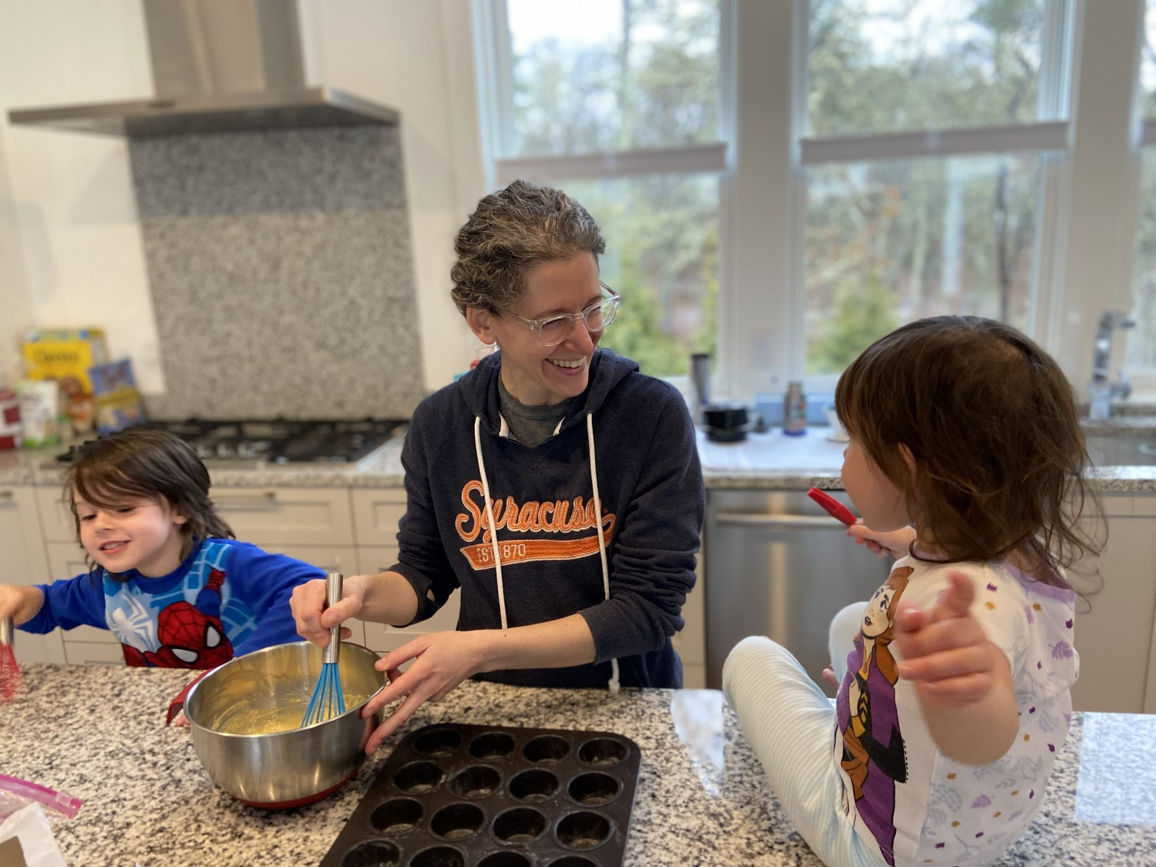
How can you help at home?

Slide 12
Maths is about everyday life!
Maths is about everyday life. We can’t do such things as shopping, cooking, telling the time, fitting flat pack furniture together, etc. without using our mathematical skills and knowledge.
Maths is everywhere and it doesn’t happen just at school or nursery.
There are opportunities for children’s maths development everywhere.
In the home
In the garden
At the shops
On the way to school
At the park

Slide 13
Maths is fun
We can develop a positive attitude to maths by
making it fun too
Count the steps as we go up or down
Look at the house numbers or bus numbers while in the street
Set the table-how many cups etc. do we need?
Match pairs of socks
Brush long or short hair
Look at how tall the flowers grow
Sing number nursery rhymes
The most important thing to remember is that it should be FUN!

Slide 14
Kitchen
Let your child help to bake/cook.
What size pan do we need?
How many more pieces of cake do we need?
What shape is the cake?

Slide 15
Shopping
Are these the same size?
Do we need a whole or half?
What number is the bus?
Is the bag heavier or lighter?
Which coins will I need?

Slide 16
Gardening
How many seed/bulbs for this hole?
Is the hole big enough for this plant?
Talk about ‘too long’ or ‘too tall’ when cutting string, bushes back.

Slide 17

Pattern and shape in the environment
Talk about shapes in patterns of everyday objects e.g. can you see the oblongs on the wall?
What shape is the road sign?

Slide 18
Songs
Nursery rhymes and songs introduce lots of maths especially counting.
1,2,3,4,5, once I caught a fish alive…
5 little monkeys jumping on a bed…
10 fat sausages sizzling in a pan…

Slide 19
Books
Take about the sequence of events, what happens next?
Is this the beginning, middle or end of the book?
Where is the front or back of the book?

Slide 20
Water
Sort mugs, plates, cutlery when washing up.
Talk about full/empty and more/ less.
Use old plastic bottles, sieves, bowls etc. in the bath.

Slide 21
Clothes
Talk about too big or too small.
Talk about shapes, pattern and colour.
Point out numbers.
Count buttons on cardigans/shirts.
Sort pairs of socks and count in 2’s.

Slide 22


Fun websites
Some useful websites and online games for children-
http://www.ictgames.com/
https://www.poissonrouge.com/
http://www.crickweb.co.uk/Early-Years.html
http://nrich.maths.org/early-years
www.mathszone.co.uk
https://www.topmarks.co.uk
Have fun!

